Slide 1
What Attributes Make Comp-Sci Professionals Most Desirable in the Workforce?
Data by Ayush Tankha
Analysis by Sam Weiss

Slide 2
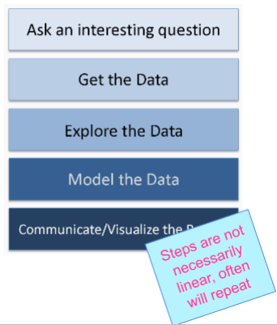
Or, put another way:
How do we get a job? (a high paying one)
This is a question close to our hearts as compsci majors and there are many parties who may wish to know the answer ranging from:
Educational institutions
Workplace recruiters
Current (or prospective) compsci students
Working professionals
So, lets answer this in the classic process flow of a data scientist. Since the question is already asked, I’ll move on to:

Slide 3

Get the Data
Fortunately, this step was fast for my project thanks to
Kaggle.com is an extremely useful website for us data scientists in training. It has everything you need from educational resources to friendly machine learning model competitions between users.
For today though, the most useful feature is its large repository of publicly hosted datasets.
One such dataset was exactly what I needed:
https://www.kaggle.com/datasets/ayushtankha/70k-job-applicants-data-human-resource
“70k+ Job Applicants Data (Human Resource)”

Slide 4
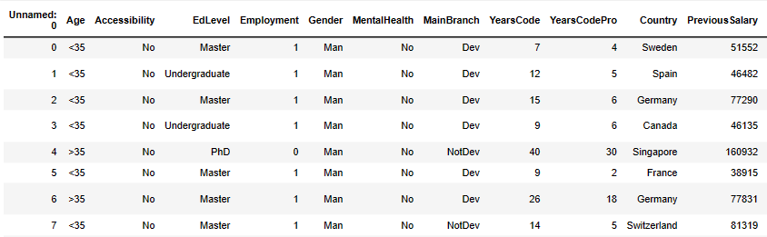
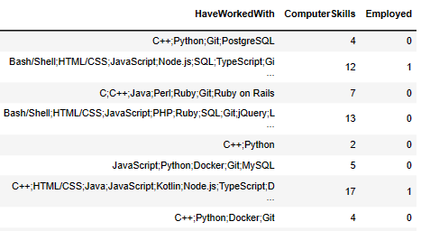
Explore the Data
According to the user who collected this data, Ayush Tankha: “this dataset has been meticulously gathered from diverse sources, including job portals, career fairs, and online applications, over a specified period. The information was collected in a standardized manner, ensuring consistency across various data points. The dataset encompasses a wide range of industries, positions, and qualifications, making it suitable for analyzing employability trends across different sectors.”
Suffice it to say, the sourcing is sufficiently rigorous. As for the format, the data in this repo is 15 columns by 73461 rows stored in a .csv format. The columns are:

Slide 5
Model the Data
Armed with this, lets try and answer: “How do you get a high paying tech job?”
Obviously, the most important column in this data set is ‘PreviousSalary’. We will use this information as a reference, to measure each other metric’s “wiseness”. If those with big degrees or who know python have the largest ’PreviousSalary’ then it is probably a good idea to pursue.
But this is not a straightforward question with a single answer. What other elements should we compare to this cardinal metric to extract the winning strategy? There is much ink spilled trying to win such an abstract game as this one, the rules are elusive and ever changing. Of the columns present, some seen the most useful for our particular investigation. Ex: ‘EdLevel’, ‘ComputerSkills’ & ’YearsCodePro’
Perhaps this game can be simplified for us if we look at the hiring decisions of modern tech firms through the right lens.
Let’s begin with the most obvious sub question!
"Do I need a degree?” or “What is the value of a degree.”

Slide 6
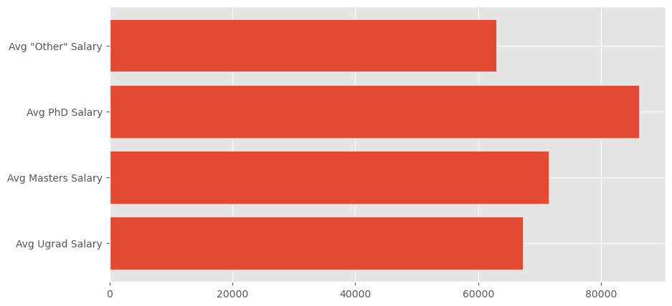
Communicate the Data pt 1.1:
Higher Education vs. Work Experience
This is an age old debate, many people are strongly opinionated in both camps. Some will tell you that getting a PHD, or even going to college at all is a waste of time while others fiercely swear by the merit of their credentials.
Let’s answer it in the most obvious way, just aggregating the salaries, delimited across each category of degree in the data set:
Here, we see the power of a degree. Yet, perhaps it is not SO powerful after all. The first thing I notice is that these salary figures do not account for many factors, such as the opportunity cost of pursuing a higher degree.

Slide 7
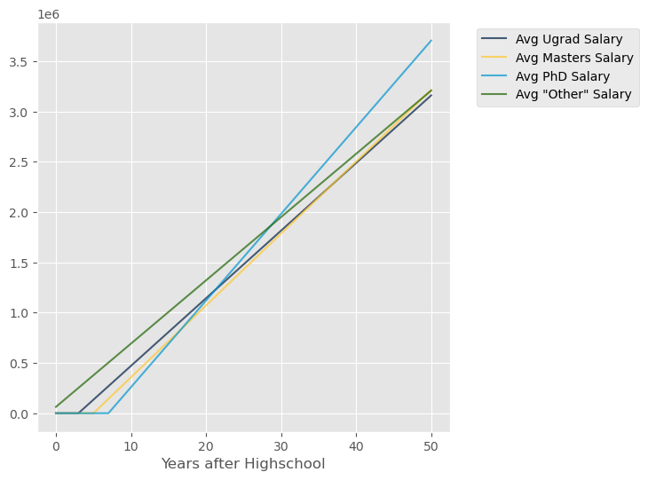
Communicate the Data pt 1.2:
Higher Education vs. Work Experience
To try and account for these, we can create a simple projection of one’s total earnings over time. This earning projection comes with some simplifying assumptions:
1. The average salary listed above is what you will earn every year of your career
2. Your college education was free (the TIME cost of a degree is the only consideration)
3. You will be hired regardless of credentials and employed continuously

Slide 8
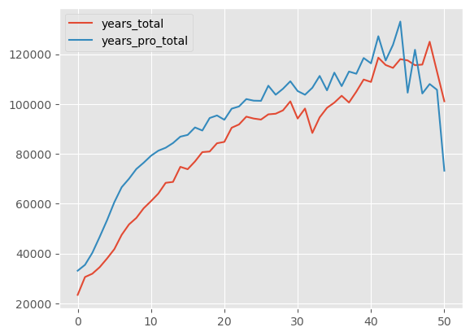
Communicate the Data pt 1.3:
Higher Education vs. Work Experience
Yet, there are still other angles to approach this question from. This data tracks “YearsCode” and “YearsCodePro” as different columns. This means that we can compare the value of work experience vs. casual coding experience with the following chart:
As you might expect, professional experience is more valuable than casual experience. Quantifiably, it is roughly 5 years more valuable each year of one’s career for the first 90% of years.
In other words, someone working professionally for 10 years can expect to make the same amount of money as someone who has been coding in total for 15 years. The same can be said about 15 to 20, 20 to 25, etc… Another strong argument for work experience.
However, this may just mean that developers wait an average of 5 years until they enter industry.

Slide 9
Communicate the Data 1.4:
Higher Education vs. Work Experience
There are many caveats that come with the above visualizations, as they only account for earning power when continuously employed and not other important factors like odds of employment, job satisfaction and many others.
However, I think the data presented today is useful and actionable for any prospective comp-sci professional.

Slide 10
Communicate the Data pt 2.1:
Most Desirable Languages to Master
You may be unsatisfied by that answer to the question “How do I get a high paying tech job”. After all, advice like “PHD’s earn a lot of money” and “work experience is key” is hardly novel…
But don’t lose your focus yet! Because I have another answer to this question that you won’t be quite so whelming! I want to know what programming skills are most desirable for our career based on current data.

Slide 11
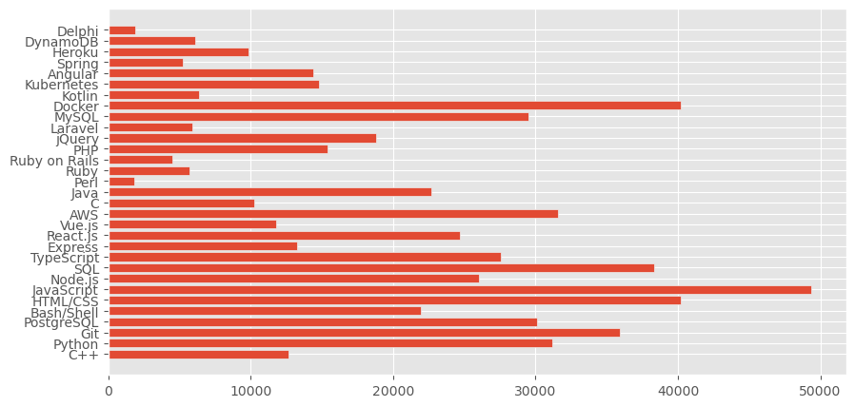
Communicate the Data pt 2.2:
Most Desirable Languages to Master
This is the supply of developer labor per each skill, for example JavaScript is a language known by 49k/74k respondents. Making it highly saturated.
This can tell us where potential labor shortages may be, but it may also just indicate which languages aren’t desired by companies, I.E. not in demand.
How to tell them apart?

Slide 12
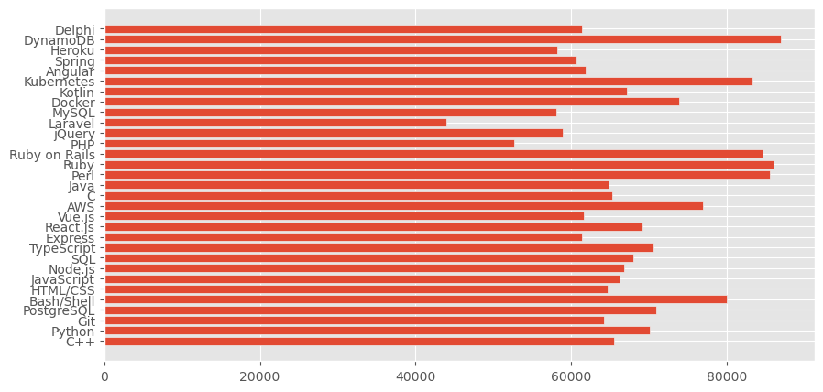
Communicate the Data pt 2.3:
Most Desirable Languages to Master
This graph shows the average salary held by a person who reported a given skill.
So those who included knowing “Laravel” on their applications expect lower salaries than those who know “PostgreSQL”

Slide 13
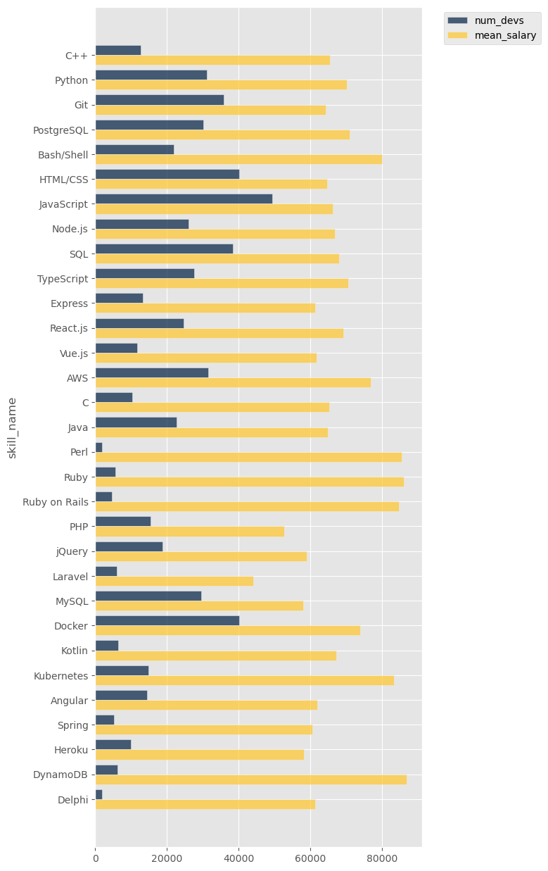
Communicate the Data Conclusion:
Most Desirable Languages to Master
Here we see the data in context!
The yellow line represents the annual salary in USD of someone with a given skill. The blue line represents the number of people in the dataset who have that skill. The difference between these bars is an indicator of desirability, meaning that the skill in question probably has high demand (pay) and low supply (competition)
This information empowers prospective comp-sci professionals like us to choose our language of focus with careful consideration. “Ruby” and “Perl”, for example are compelling choices for a next language to learn.

Slide 14
FIN

